Slide 1
Algorithm design
Introduction to computational thinking

Slide 2
What is an algorithm?
The algorithm is a set of instructions given to the computer so it can provide a solution to a posted problem
- Applied Computational Thinking with Python, Packt, 2020, p. 35

Slide 3
Result of the algorithm design process
One or more clear algorithms that can be
implemented,
tested,
and solve a specific problem

Slide 4
Examples
Driving directions: given a start and end location, the directions list step-by-steps actions (turn-by-turn navigation) using GPS to find an optimal route
Designing a machine learning pipeline: steps to preprocess data (cleaning, normalization)

Slide 5

SAMPLE
ALGORITHM
Solve
ax + b = 0

Slide 6
Algorithm representation
Natural language
Pseudo code
Flow chart
Activity diagram

Slide 7
1. Algorithm - Natural language
Input: Two real number a, b
Output: Solution of the equation ax + b = 0
Input two real numbers a and b
If a = 0 then
2.1. If b = 0 then
2.1.1. The equation has an infinite number of solutions
2.1.2. End the algorithm
2.2. On the contrary, if b is not equal to 0 then
2.2.1. The equation has no solution.
2.2.2. End the algorithm
On the contrary, if a is not equal to 0 then
3.1. The equation has one solution, x = -b / a
3.2. End the algorithm

Slide 8
2. Algorithm - Pseudo code
Input: Two real number a, b
Output: Solution of the equation ax + b = 0
Input real number a, input real number b
If a = 0:
If b = 0:
print “The equation has an infinite number of solutions”
Else:
print “The equation has no solution”
Else:
print “The equation has one solution: x = “, -b / a

Slide 9
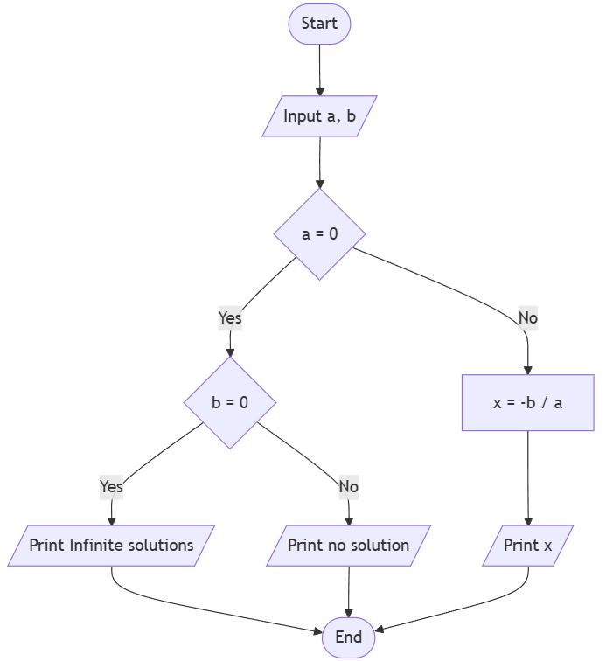
3. Algorithm - Flowchart
Notes:
flowchart TD
Start([Start]) --> Input[/Input a, b/]
Input --> CheckA{ a = 0 }
CheckA --> |Yes| CheckB{ b = 0}
CheckB --> |Yes| Infinite[/Print Infinite solutions/] --> End
CheckB --> |No| NoSol[/Print no solution/] --> End
CheckA --> |No| FindX[x = -b / a] --> Print[/Print x/] --> End
End([End])

Slide 10
Tips
Define clear objectives: algorithm, process, or UX flow.
Follow standard notation and maintain consistency throughout the flowchart.
Maintain a balance of detail: enough to understand the logic, not overly detailed.
Clearly define input/output for each module or step.
Use clean arrows, avoid overlaps → makes the flow easy to follow.
Consider edge cases and exception paths.
Modularize: split large sections into sub-flowcharts.
Link to pain points / requirements → ensure the flowchart addresses real problems.
Continuously update the flowchart when requirements or code change.

Slide 11
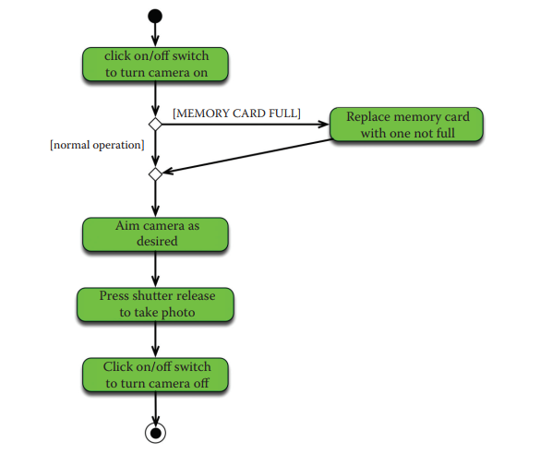
4. Algorithm - Activity diagram

Slide 12
Tools used
Mermaid.live
Notion
VS Code + Markdown with Mermaid support extension

Slide 13
Characteristics of an algorithm
Clear & unambiguous
Well-defined inputs & outputs, must define:
Input: data, parameters, constraints
Output: desired results, success criteria
Constraints and Assumptions
Algorithm limitations to consider:
Performance (time, memory)
Data constraints (missing, incomplete)
External constraints (API limits, network latency)
Assumptions must be explicitly stated (e.g., user has Internet connection, location data is valid)

Slide 14
Other artifacts

Slide 15
Validation & Test Cases
Unit tests / example input-output to verify the algorithm.
Confirm that the algorithm:
Produces correct results (correctness)
Is efficient (efficiency)
Handles edge cases

Slide 16
Complexity / Performance Analysis
Assess complexity:
Time Complexity
Space Complexity
Scalability

Slide 17
Documentation
Explain the algorithm, logic, design decisions, and trade-offs.
Helps other team members understand, maintain, and reuse the algorithm.

Slide 18
Summary
Algorithm design output = {
Clear Algorithm
+ Input/Output
+ Constraints/Assumptions
+ Pseudocode/Diagram
+ Validation/Test Cases
+ Performance Analysis
+ Documentation
}

Slide 19
Problems in algorithm design

Slide 20
A. Problem Formulation
The problem itself is misunderstood
Unclear input/output definitions → the algorithm lacks a concrete goal
Ignoring constraints such as time, memory, or limits on input size
Failure to model the real-world problem into a computable form (e.g., not converting to a graph or search problem)
No estimation of acceptable complexity → the algorithm may be theoretically correct but practically unusable.
Misunderstanding optimization goals (e.g., minimizing cost vs maximizing performance)

Slide 21
Does not address the correct problem / pain point
The algorithm may run “fine” but does not solve the user’s real problem.
Example: designing a “route optimization” algorithm that only optimizes the number of waypoints, not travel time → does not reduce the user’s planning time.

Slide 22
B. Algorithm Structure Design
Poor structural design often leads to inefficiency or logical errors
Choosing the wrong algorithmic paradigm (e.g., using greedy instead of dynamic programming).
Failure to decompose the problem into subproblems, missing opportunities for divide-and-conquer or DP.
Undefined termination condition in recursion or iteration.
Lack of generality, solving only a special case.
No formal reasoning or proof of correctness → the algorithm might “seem to work” but fails under edge conditions.

Slide 23
Overly complex / over-engineering
Designing an algorithm that is too elaborate or over-optimized for all cases leads to:
Hard to understand, hard to maintain
Longer development time
Example: using complex AI/heuristics in a Smart Travel System when a simple greedy approach is sufficient

Slide 24
Too simple / under-engineering
The algorithm is too basic and ignores edge cases → produces incorrect or unstable results.
Example: a route optimization algorithm that ignores opening-hour constraints of destinations.

Slide 25
C. Algorithm Analysis and Evaluation
No estimation of time or space complexity
E.g. (O(n), O(log n), etc.).
Failure to compare multiple solution approaches.
Confusing average-case with worst-case analysis.
Ignoring edge cases during testing, leading to instability or crashes.
The algorithm only covers “ideal” cases → easily fails with real-world data.
Example: user selects a travel date that falls on a holiday, or a destination lacks data → the algorithm crashes or returns incorrect results.

Slide 26
Not considering performance / scalability
An algorithm may work well on small datasets but does not scale to large data or many concurrent users.
Example: route optimization O(n!) → works for 5–6 points but becomes slow or crashes for 10–15 points

Slide 27
Ignoring constraints / non-functional requirements
The algorithm must consider:
Execution time
API/resource limits
Memory usage
UX (time-on-task, latency)
Example: a route calculation algorithm is too slow → users abandon the app.

Slide 28
Example of algorithm analysis

Slide 29
Problem
Find the top-k smallest elements in an unsorted array in C++

Slide 30
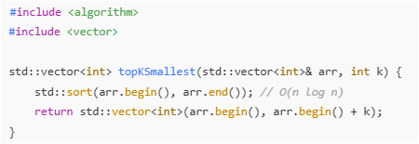
1. Sort the whole array and take the first k elements
Time complexity: O(n log n)
Pros: Simple and easy to implement
Cons: Sorting the entire array is unnecessary if k << n

Slide 31
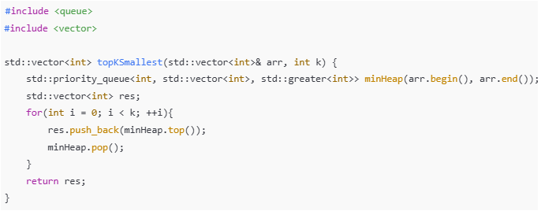
2.1. Min-heap (priority_queue) of the whole array
Time complexity: O(n + k log n) ~ O(n) if k << n
Pros: No need to sort the whole array
Cons: Uses O(n) extra memory

Slide 32
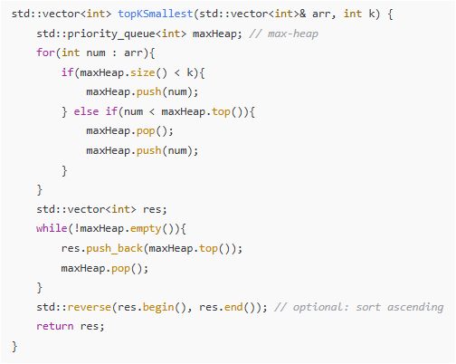
2.2. Max-heap of size k
Iterate through the array, maintain a heap of size k. If a new element is smaller than the max of the heap, replace it.

Slide 33
3. QuickSelect (k-th element selection)
Based on QuickSort partition, select the k-th smallest element, then take all elements ≤ pivot.
Time complexity: O(n) on average, O(n²) worst case
Pros: No need to sort the whole array, in-place O(1) memory if using the original array
Suitable when n is large and k is small, aiming for O(n) average time

Slide 34
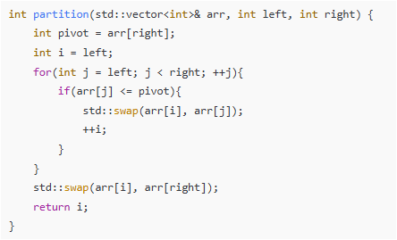
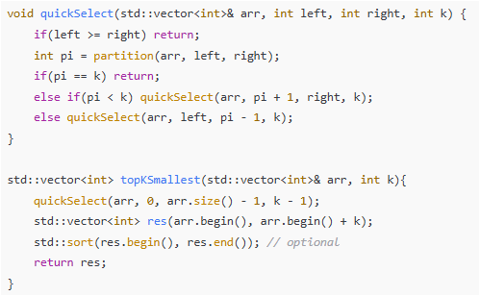
Sample source code

Slide 35
Dry run
[7, 2, 1, 8, 6, 3, 5, 9, 4, 0] (10 elements, top k = 4)
left = 0, right = 9, target index k-1 = 3
Step 1 — partition (left=0, right=9)
pivot = arr[9] = 0
Scan j = 0..8: no element ≤ 0
Swap pivot with arr[i] (i = 0)
Array becomes: [0, 2, 1, 8, 6, 3, 5, 9, 4, 7]

Slide 36
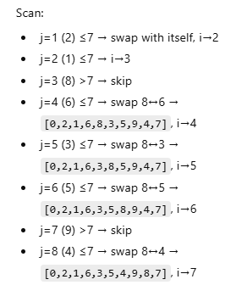
Array is [0, 2, 1, 8, 6, 3, 5, 9, 4, 7]
Step 2 — partition (left=1, right=9)
Subarray: [2,1,8,6,3,5,9,4,7]
pivot = 7
i = 1

Slide 37
[0,2,1,6,3,5,4,9,8,7]
Now swap pivot 7 with arr[7]:
[0,2,1,6,3,5,4,7,8,9]
pivot index pi = 7
Compare: pi = 7 > 3 ⇒ go left side
Continue with left = 1, right = 6.

Slide 38
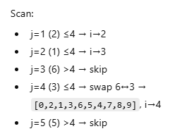
Step 3 — partition (left=1, right=6)
Subarray: [2,1,6,3,5,4]
pivot = 4
i = 1

Slide 39
[0,2,1,3,6,5,4,7,8,9]
Swap pivot (4) with arr[4]:
[0,2,1,3,4,5,6,7,8,9]
pivot index pi = 4
Compare: pi = 4 > 3 ⇒ continue left
Next: left = 1, right = 3.

Slide 40

Step 4 — partition (left=1, right=3)
Subarray: [2,1,3]
pivot = 3
i = 1
[0,2,1,3,4,5,6,7,8,9]
pivot index pi = 3
Compare: pi == 3 ⇒ target found

Slide 41
Final Result from the Trace
When pi == k-1, we stop.
[0,2,1,3,4,5,6,7,8,9]
The first 4 elements of the array now contain the 4 smallest values (not necessarily sorted yet):

Slide 42
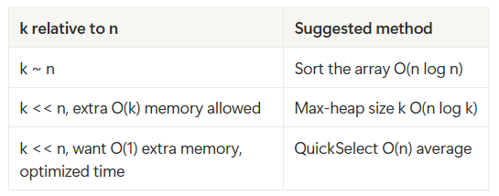
Conclusion
choose method based on the scenario

Slide 43
D. Abstraction and Generalization
Not separating essential logic from contextual details
Low reusability → the algorithm works only in one scenario
Failure to recognize recurring patterns, preventing transfer learning
Poor mapping between problem type and data structure

Slide 44
E. Representation and Implementation
Even well-designed algorithms can fail during implementation if the representation is wrong
Inappropriate data structures (using lists instead of heaps, etc.).
Mixing data handling with control logic, making debugging hard.
Confusion between algorithmic logic and heuristic approximations.
Ignoring numerical or data-type limitations (overflow, rounding errors).

Slide 45
Not modular / reusable
The algorithm is written too “hard-coded” → cannot be reused by other modules.
Example: “Route Optimization for Hanoi only” → cannot be used for Ho Chi Minh City or Da Nang.

Slide 46
Not validated with real data
The algorithm is tested only on synthetic data → real-world performance/accuracy is unknown.
Example: recommending hotels based on artificial ratings, while real ratings contain a lot of bias → wrong recommendations.

Slide 47
Not documented / not explainable
A complex algorithm without documentation, pseudocode, or explanation → difficult to debug, refactor, or hand over.

Slide 48
Tips to avoid problems in Algorithm Design
Start with a clear specification: input, output, constraints, success criteria
Understand the pain points / requirements → ensure the algorithm solves the right problem
Choose an appropriate level of complexity: start simple → optimize later
Break the algorithm into modular, reusable components
Consider performance & scalability upfront
Handle edge cases & exceptions during the design phase
Test with real-world data & simulated edge scenarios
Document using pseudocode, diagrams, comments for team clarity and maintainability

Slide 49
Acvitities
Work in group to find examples for 2 problems listed above
Then present in class

Slide 50
Representation
Result of algorithm design

Slide 51
Activity 01
Design an algorithm to solve the equation ax² + bx + c = 0

Slide 52
Activity 02
Choose 3 types of diagrams supported by Mermaid
In the context of project topic: “Smart travel system”, how could these diagrams help? Explain what does the diagram do and give an example for each of the diagram using the context “Smart travel system”
Create a Google slide (what->why->how)
Submit back the link inside a txt file in the format of StudentsID (ID1_ID2_…_ID4.txt)

